Slide 1
High Performance Pressure-Driven Pipe Flow
Bintang A.S.W.A.M, Advanced Computational Science
Albina Lyubitskaya, Petroleum Engineering

Slide 2
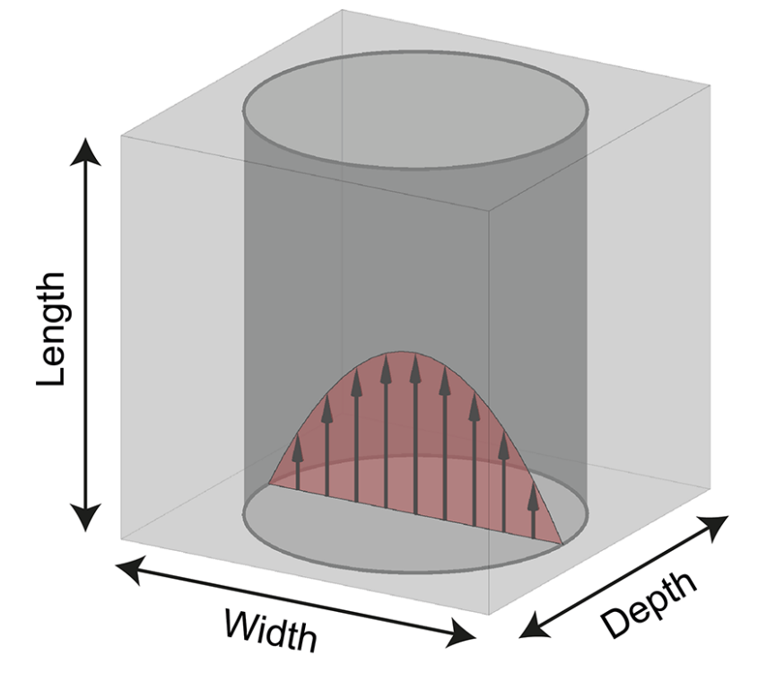
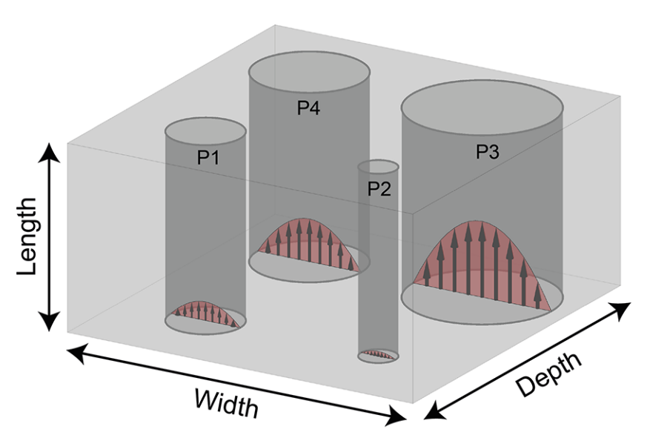
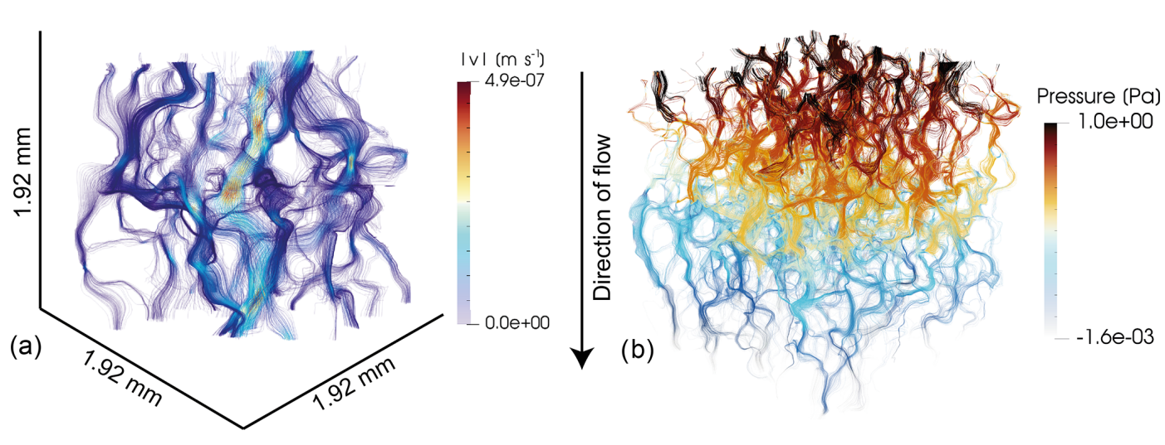
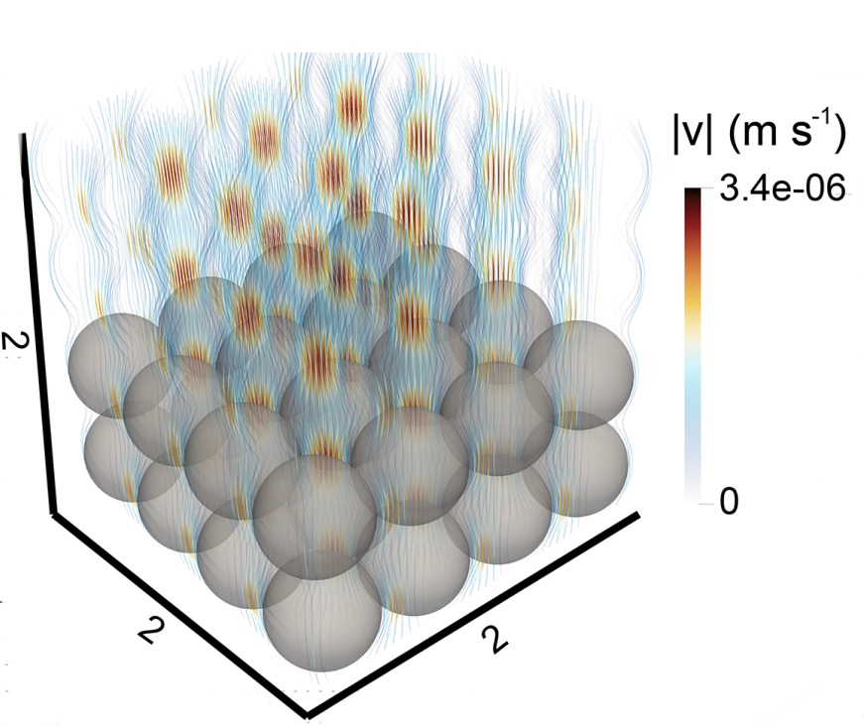
Application of studying the pressure-driven flow in oil and gas fields investigations
The flow of fluids through porous media such as groundwater flow or oil migration is a key process in geological sciences. Flow is controlled by the permeability of the rock; thus, an accurate determination and prediction of flow value is of crucial importance.
Newtonian flow through a single vertical tube
Newtonian flow through multiple vertical tubes
Computing permeabilities and understanding the microstructures and flow patterns in 3D pore structures are achieved with numerical modeling. In recent years, the flow of non-Newtonian fluids through porous media has gained additional importance due to the use of nanofluids for enhanced oil recovery.
Newtonian fluid flow through the Fontainebleau sandstone sample. Streamlines colored using computed fluid velocities are shown in panel (a) and streamlines colored using fluid pressures are shown in panel (b).
Newtonian flow through simple cubic (SC) sphere pack

Slide 3
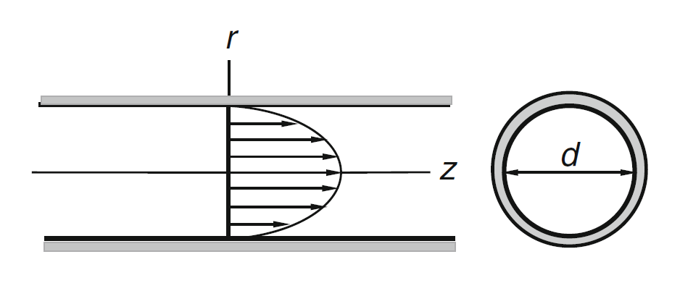
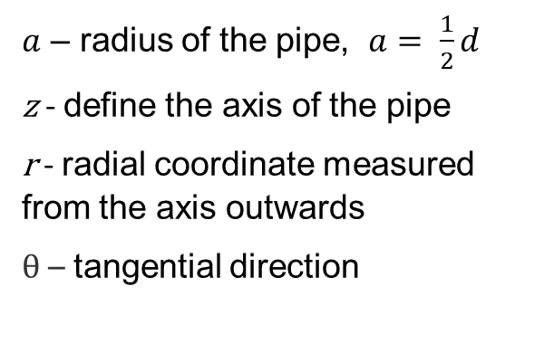
Analytical derivation of Hagen-Poiseuille Flow
Relevant physical assumptions:
Steady -state flow
The velocity profile of u_{r}, u_{θ} could be neglected
Fully developed-based drifting flow will be physically considered
Three-dimensional Hagen–Poiseuille flow is the steady flow of an incompressible fluid through a straight pipe of circular cross-section with rotational symmetry (Schlichting, 1960).
$a$ – radius of the pipe, $a= \frac{1}{2}d$
z - define the axis of the pipe
r - radial coordinate measured from the axis outwards
θ – tangential direction
θ

Slide 4
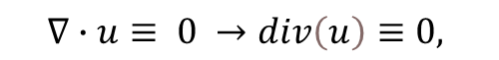
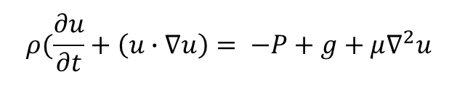
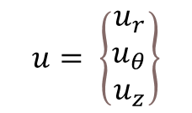
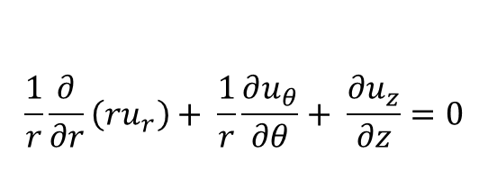
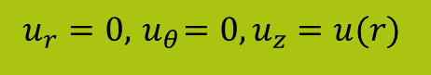
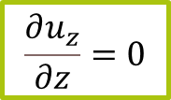
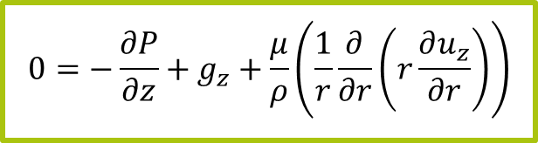
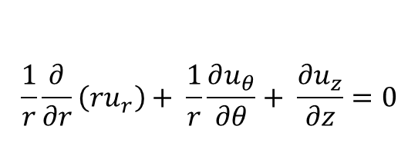
Analytical derivation of Hagen-Poiseuille Flow
Hagen-Poiseuille flow is a steady unidirectional axisymmetric flow in a circular cylinder. Thus, we look for the velocity field in cylindrical coordinates in the following form:
$$u_{r}=0, { u}_{θ}=0, u_{z}=u(r)$$
1.Continuity Equation
2. Momentum Equation
(the Navier–Stokes equation)
incompressible flow
$$ρ(\frac{∂u}{∂t}+\left(u∙∇u\right)= −P+g+μ∇^{2}u$$
incompressible flow
incompressible flow
$$u= \left\{\begin{matrix}u_{r} \\ u_{θ} \\ u_{z}\end{matrix}\right\}$$
$$∇∙u≡ 0 →div\left(u\right)≡0,$$
In z-direction:
$$\frac{1}{r}\frac{∂}{∂r}\left(ru_{r}\right)+ \frac{1}{r}\frac{∂u_{θ}}{∂θ}+ \frac{∂u_{z}}{∂z}=0$$
$$\frac{1}{r}\frac{∂}{∂r}\left(ru_{r}\right)+ \frac{1}{r}\frac{∂u_{θ}}{∂θ}+ \frac{∂u_{z}}{∂z}=0$$
$$\frac{1}{r}\frac{∂}{∂r}\left(ru_{r}\right)+ \frac{1}{r}\frac{∂u_{θ}}{∂θ}+ \frac{∂u_{z}}{∂z}=0$$
In z-direction:
$ρ\left(\frac{∂u_{z}}{∂t}+\frac{∂u_{z}}{∂r}\frac{dr}{dt}+\frac{∂u_{z}}{∂z}\frac{dz}{dt}\right)= −\frac{∂P}{∂z}+μ\left(\frac{1}{r}\frac{∂}{∂r}\left(r\frac{∂u_{z}}{∂r}\right)+\frac{∂^{2}u_{z}}{∂z}\right)+g_{z}$
= 0
$$ρ\left(\frac{∂u_{z}}{∂t}+u_{r}\frac{∂u_{z}}{∂r}+u_{z}\frac{∂u_{z}}{∂z}\right)=−\frac{∂P}{∂z}+g_{z}+μ\left(\frac{1}{r}\frac{∂}{∂r}\left(r\frac{∂u_{z}}{∂r}\right)+\frac{∂^{2}u_{z}}{∂z^{2}}\right)=0$$
= 0
= 0
= 0
= 0
= 0
u - velocity
z - define the axis of the pipe
r - radial coordinate measured from the axis outwards
θ - the radial coordinate measured from the axis outwards
= 0
= 0
$$\frac{∂u_{z}}{∂z}=0$$
$$0=−\frac{∂P}{∂z}+g_{z}+\frac{μ}{ρ}\left(\frac{1}{r}\frac{∂}{∂r}\left(r\frac{∂u_{z}}{∂r}\right)\right)$$

Slide 5
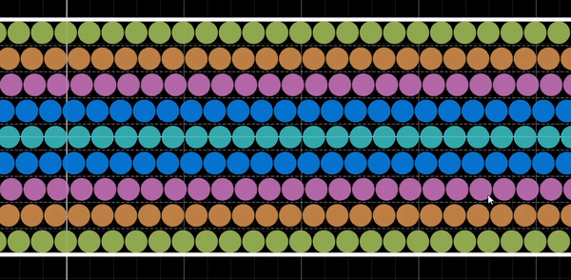
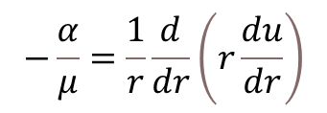
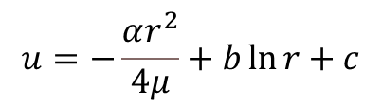
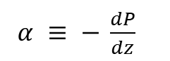
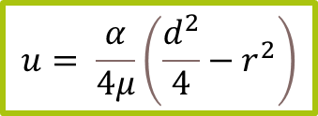
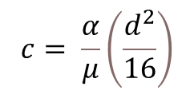
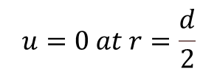
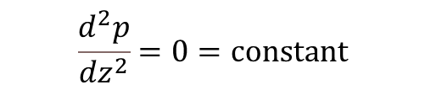
Analytical derivation of Hagen-Poiseuille Flow
P depends only on z and:
$$\frac{d^{2}p}{dz^{2}}=0=constant$$
$α ≡ − \frac{dP}{dz}$
$$−\frac{α}{μ}=\frac{1}{r}\frac{d}{dr}\left(r\frac{du}{dr}\right)$$
Integration of the preceding equation gives:
$$u=−\frac{αr^{2}}{4μ}+b\ln{r}+c$$
Visualization of Hagen-Poiseuille Flow
Since velocity must be bounded in the flow region, the integration constant must be zero. Now the nonslip condition on the cylindrical wall demands that:
$$u=0 at r=\frac{d}{2}$$
$$c= \frac{α}{μ}\left(\frac{d^{2}}{16}\right)$$
$$u= \frac{α}{4μ}\left(\frac{d^{2}}{4}−r^{2}\right)$$
the velocity over the cross-section is distributed in the form of a paraboloid.
and
The maximum velocity is at r = 0

Slide 6
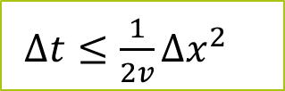
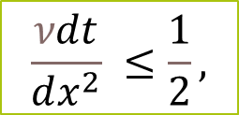
Courant-Friedrichs-Lewy Condition
Courant-Friedrichs-Lewy Condition states that, given a space discretization, a time step bigger than some computable quantity should not be taken. Thus the time step must be kept small enough so that information has enough time to propagate through the space discretization.
For any explicit simple linear convection problem, the Courant number must be equal or smaller than 1, otherwise, the numerical viscosity would be negative.
The explicit scheme is conditionally stable under the following CFL-type condition:
$∆t≤\frac{1}{2v}∆x^{2}$
$$\frac{νdt}{dx^{2}} ≤\frac{1}{2},$$
v – kinematic viscosity, t – time-step length

Slide 7
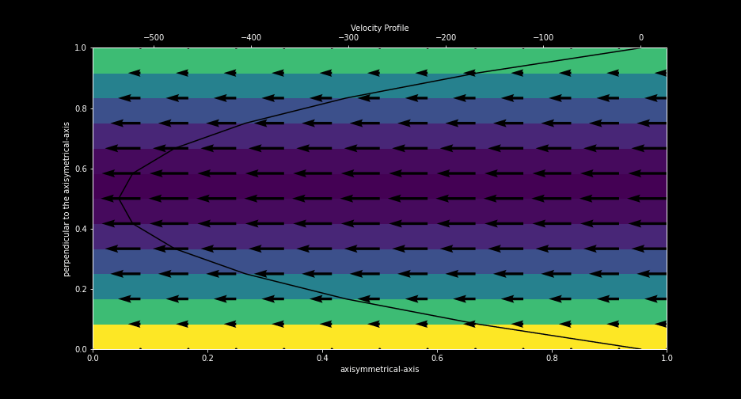
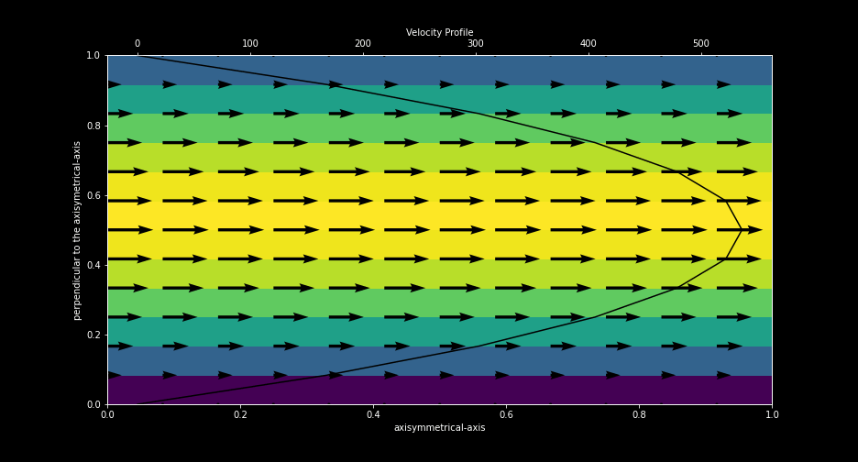
Pressure gradient
Adverse parabolic flow, >0
Favorable parabolic flow, <0

Slide 8
References
Eichheimer, P. et al. (2019) “Pore-scale permeability prediction for newtonian and non-newtonian fluids,” Solid Earth, 10(5), pp. 1717–1731. Available at: https://doi.org/10.5194/se-10-1717-2019.
Elsevier (no date) Introduction to continuum mechanics, Introduction to Continuum Mechanics - 4th Edition. Available at: https://www.elsevier.com/books/introduction-to-continuum-mechanics/rubin/978-0-7506-8560-3 (Accessed: December 22, 2022).
Straub, D. (1996) Chapter 8 - Paradigmata are the winners' dogmata: Semantic scholar, Mathematics in science and engineering. Available at: https://www.semanticscholar.org/paper/Chapter-8-Paradigmata-Are-the-Winners%E2%80%99-Dogmata-Straub/5edc01faad22989d13a0d5739d2611865a8f0660 (Accessed: December 22, 2022).

